Slide 1
KNOWLEDGE REPRESENTATION

Slide 2
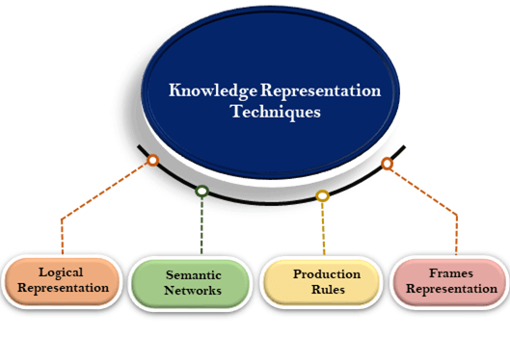
Techniques of knowledge representation
There are mainly four ways of knowledge representation which are given as follows:
Logical Representation
Semantic Network Representation
Frame Representation
Production Rules

Slide 3
1. Logical Representation
Logical representation is a language with some concrete rules which deals with propositions and has no ambiguity in representation. Logical representation means drawing a conclusion based on various conditions. This representation lays down some important communication rules. It consists of precisely defined syntax and semantics which supports the sound inference. Each sentence can be translated into logics using syntax and semantics.
2. Semantic Network Representation
Semantic networks are alternative of predicate logic for knowledge representation. In Semantic networks, we can represent our knowledge in the form of graphical networks. This network consists of nodes representing objects and arcs which describe the relationship between those objects. Semantic networks can categorize the object in different forms and can also link those objects. Semantic networks are easy to understand and can be easily extended.

Slide 4
3. Frame Representation
A frame is a record like structure which consists of a collection of attributes and its values to describe an entity in the world. Frames are the AI data structure which divides knowledge into substructures by representing stereotypes situations. It consists of a collection of slots and slot values. These slots may be of any type and sizes. Slots have names and values which are called facets. The various aspects of a slot is known as Facets.
4. Production Rules
Production rules system consist of (condition, action) pairs which mean, "If condition then action". It has mainly three parts:
The set of production rules
Working Memory
The recognize-act-cycle
In production rules agent checks for the condition and if the condition exists then production rule fires and corresponding action is carried out.

Slide 5
Conceptual Dependency
Conceptual Dependency originally developed to represent knowledge acquired from natural language input. The goals of this are:
To help in the drawing of inference from sentences.
To be independent of the words used in the original input.
That is to say: For any 2 (or more) sentences that are identical in meaning there should be only one representation of that meaning.
It has been used by many programs that portend to understand English (MARGIE, SAM, PAM). CD developed by Schank et al. as were the previous examples.
CD provides:
a structure into which nodes representing information can be placed
a specific set of primitives
at a given level of granularity.
Sentences are represented as a series of diagrams depicting actions using both abstract and real physical situations.

Slide 6
The agent and the objects are represented
The actions are built up from a set of primitive acts which can be modified by tense.
Examples of Primitive Acts are:
ATRANS-- Transfer of an abstract relationship. e.g. give.
PTRANS-- Transfer of the physical location of an object. e.g. go.
PROPEL-- Application of a physical force to an object. e.g. push.
MTRANS-- Transfer of mental information. e.g. tell.
MBUILD-- Construct new information from old. e.g. decide.
SPEAK-- Utter a sound. e.g. say.
ATTEND-- Focus a sense on a stimulus. e.g. listen, watch.
MOVE-- Movement of a body part by owner. e.g. punch, kick.
GRASP-- Actor grasping an object. e.g. clutch.
INGEST-- Actor ingesting an object. e.g. eat.
EXPEL-- Actor getting rid of an object from body. e.g. ????.

Slide 7

Six primitive conceptual categories provide building blocks which are the set of allowable dependencies in the concepts in a sentence:
PP-- Real world objects.
ACT-- Real world actions.
PA-- Attributes of objects.
AA-- Attributes of actions.
T-- Times.
LOC-- Locations.
How do we connect these things together?
Consider the example:
John gives Mary a book

Slide 8
Arrows indicate the direction of dependency. Letters above indicate certain relationships:
o-- object.
R-- recipient-donor.
I-- instrument e.g. eat with a spoon.
D-- destination e.g. going home.
Double arrows () indicate two-way links between the actor (PP) and action (ACT).
The actions are built from the set of primitive acts (see above)

Slide 9
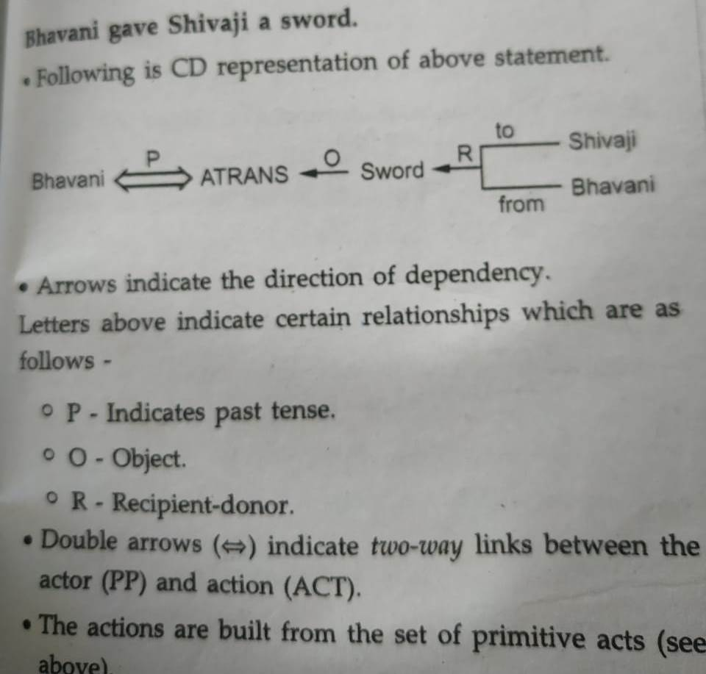

Slide 10
These can be modified by tense etc.The use of tense and mood in describing events is extremely important and schank introduced the following modifiers:
p– past
f– future
t-- transition-- start transition-- finished transition
k– continuing
?– interrogative
/-- negative
delta– timeless
c– conditional
the absence of any modifier implies the present tense.

Slide 11
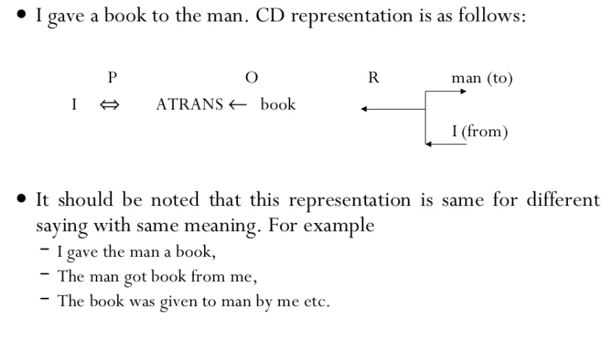

Slide 12
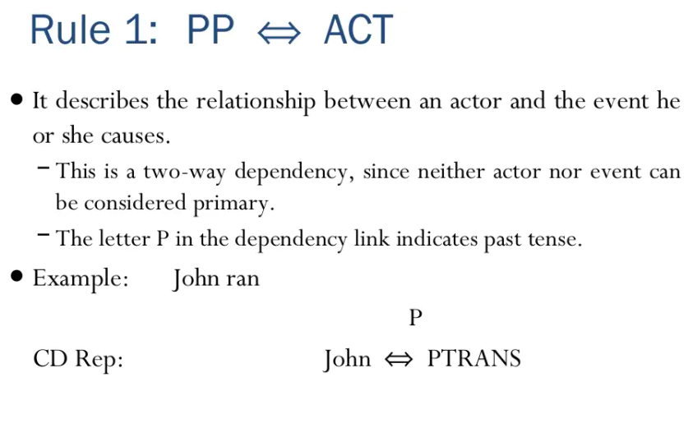

Slide 13
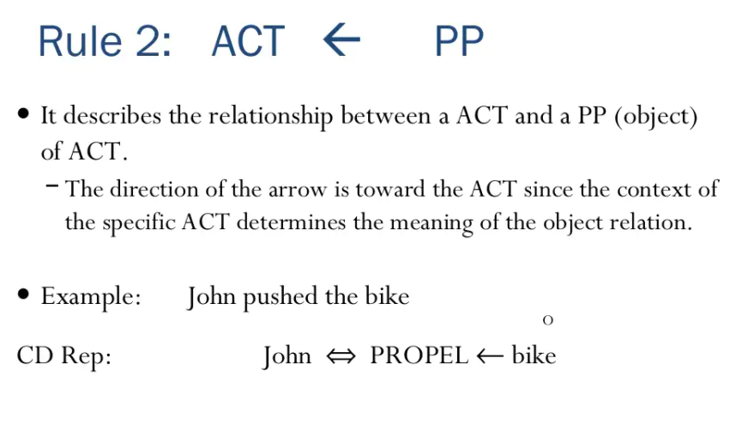

Slide 14
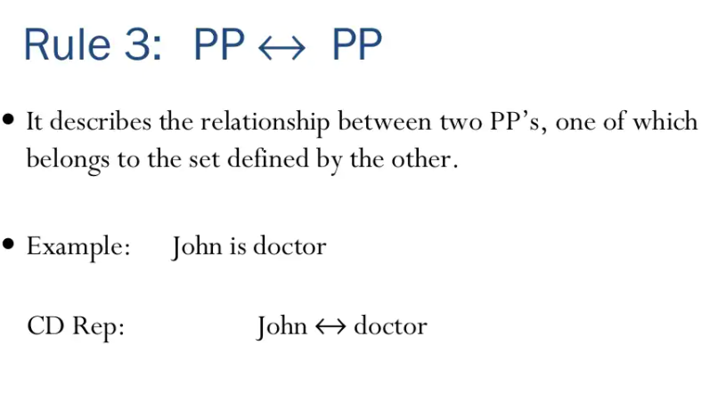

Slide 15
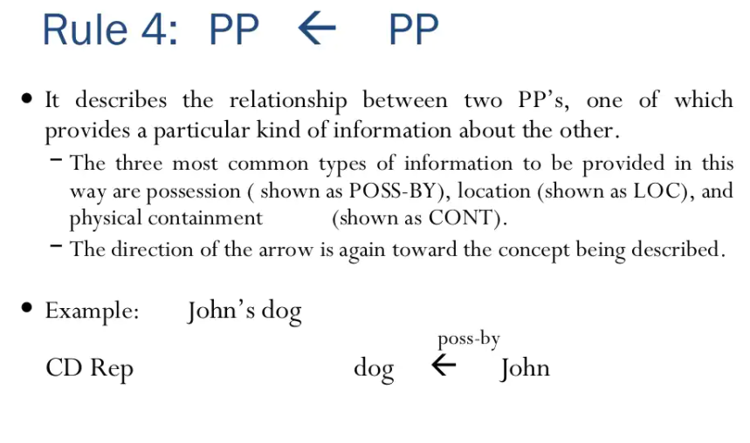

Slide 16
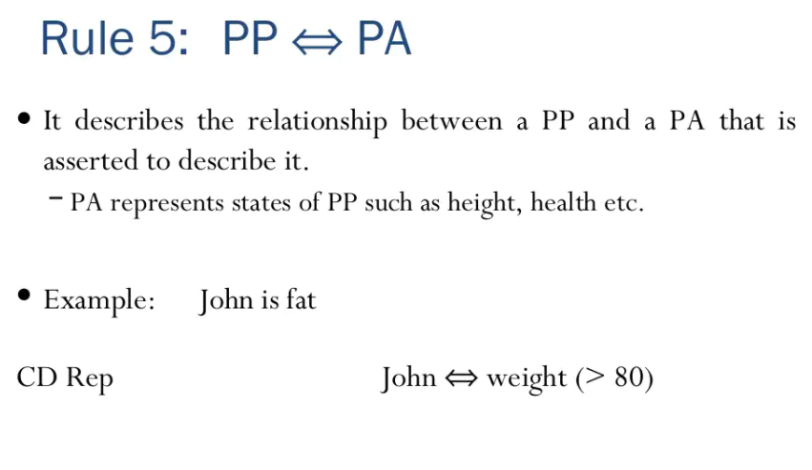

Slide 17
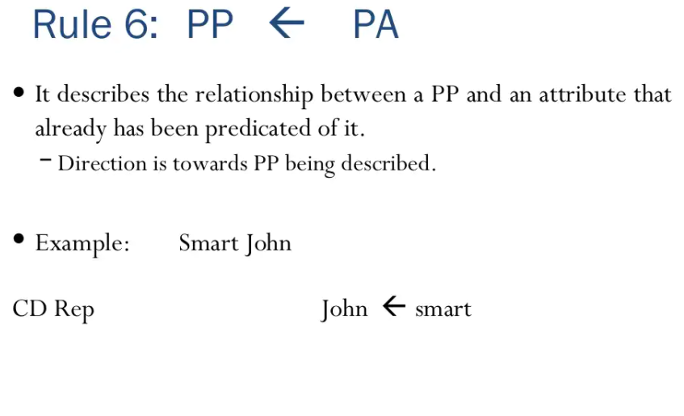

Slide 18
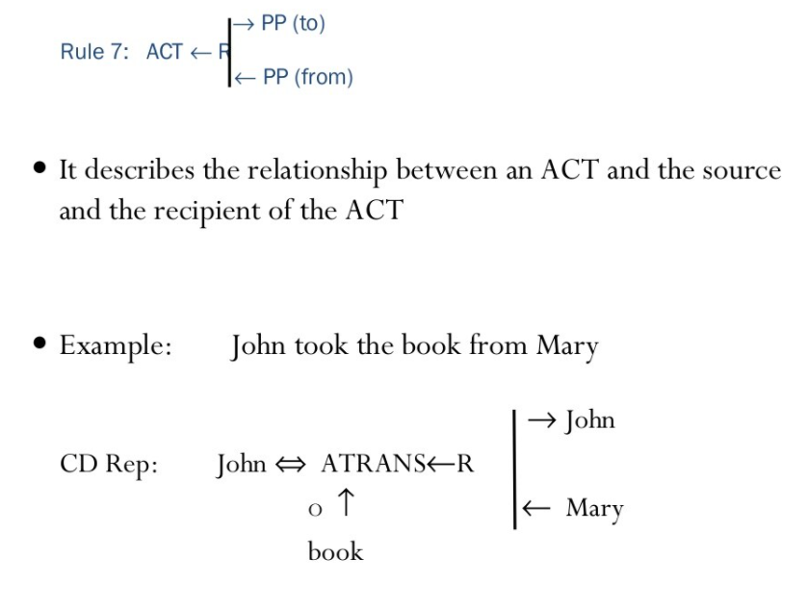

Slide 19
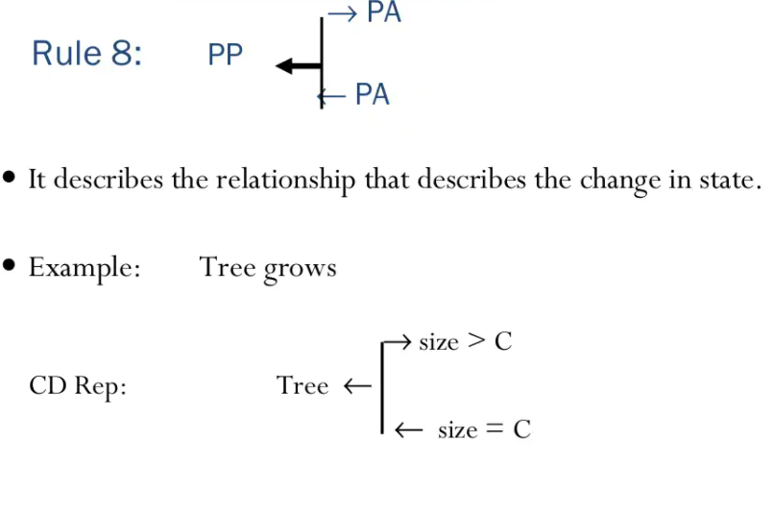

Slide 20
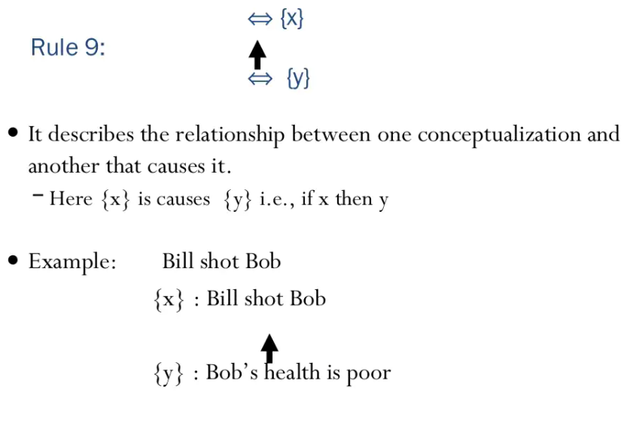

Slide 21
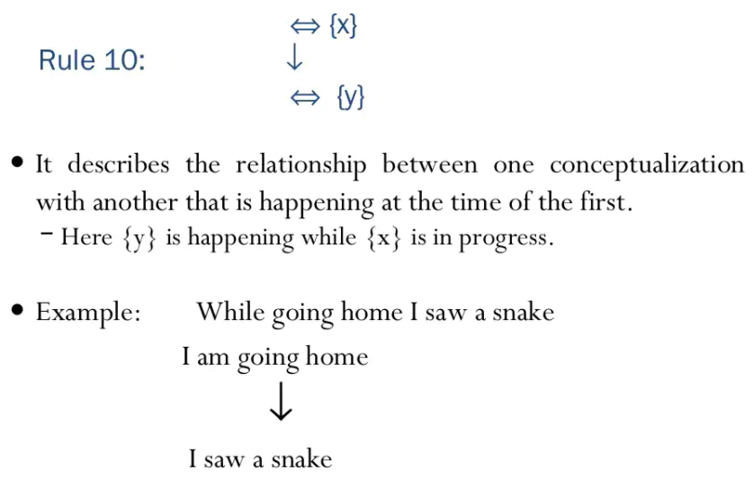

Slide 22
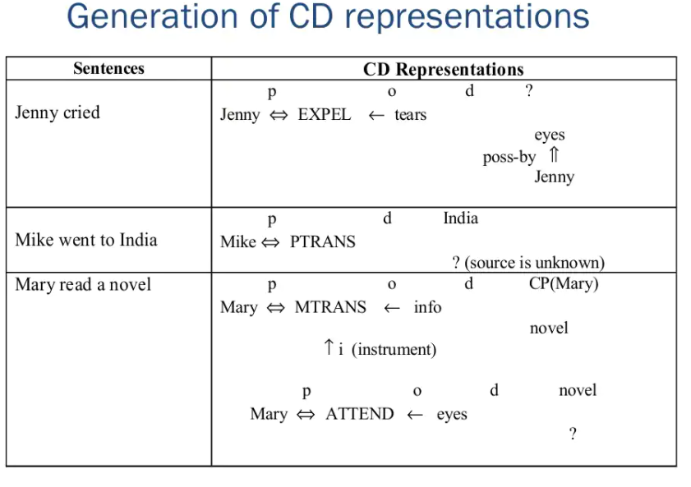

Slide 23
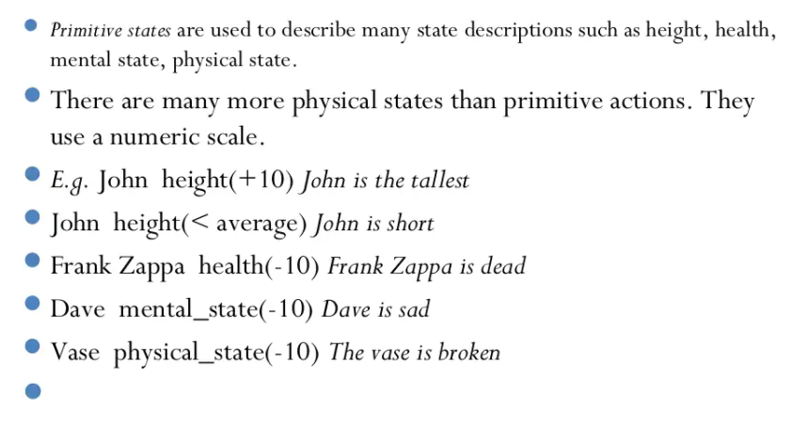

Slide 24
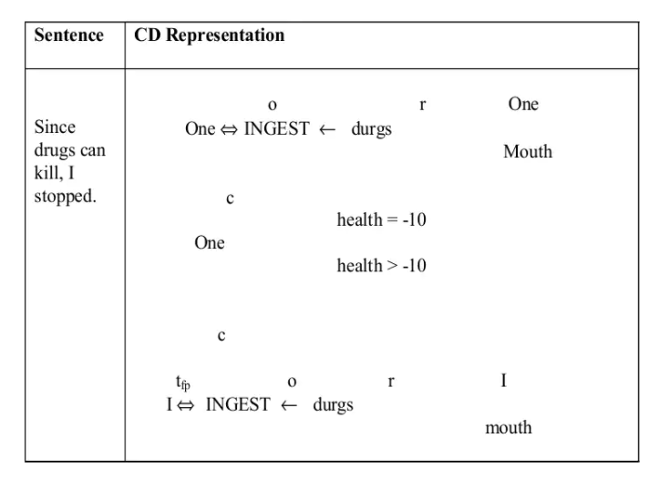

Slide 25
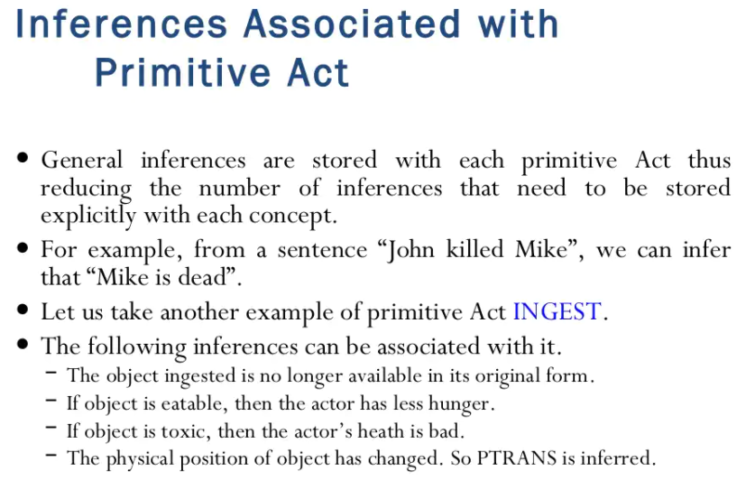

Slide 26
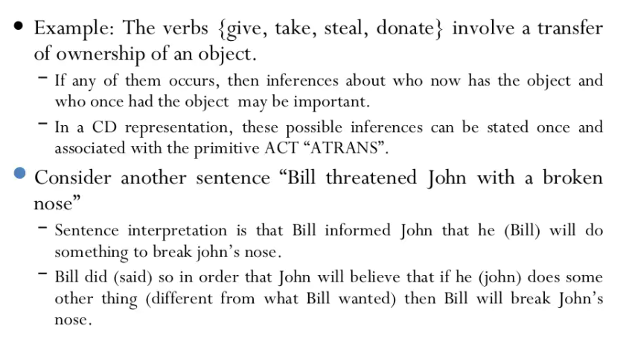

Slide 27
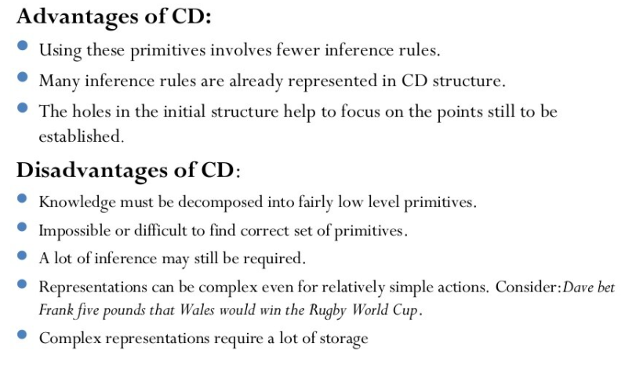

Slide 28
Frames
A frame is a group of properties identifying the condition of an object, and this object is related with other frames or objects. Actually a frame is more than only a record or perhaps a data structure that contains data. In artificial intelligence the frame is known as a slot-filler knowledge representation method. The frame technique includes a number of frames or nodes that are related to each other by relationships. Every frame explains both an instance and a class frame.
Every frame provides a number of slots which are designated as slot values. This is the way the frame network is created. Instead of simply processing links among frames, every relationship is indicated by away from a value being put into any slot.

Slide 29
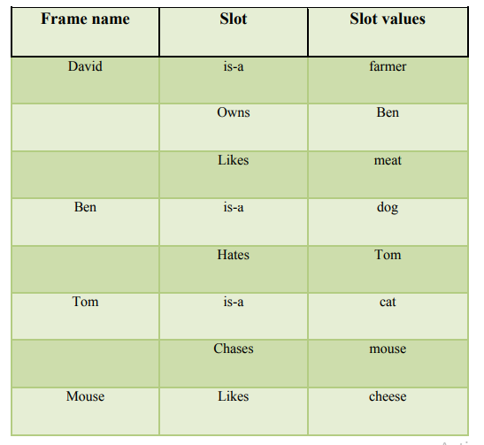
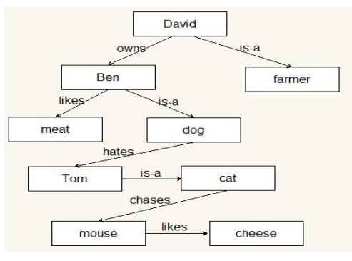
Figure1. Representation of semantic network in the form of frame

Slide 30
Whenever we point out that “Ben is a dog“, we actually mean that “Ben is an instance with the class of dog“ or “Ben can be a member of the class of dogs“. The “is a“ connection is important in a frame-based system, it permits to state a membership associated with classes. This connection can be referred as a generalization. Some other relations are generally called association. An instance of such a connection is the “hates” relationship shown in figure 1. This clearly shows that how Ben and Tom are related with each other. This relationship (association) has two direction meanings. The point that Ben hates Tom shows that Tom is hated by Ben, therefore we’re truly indicating two relationships in a single association.
The frame is just like a record construction and related to the fields and values which are generally slots as well as slot fillers. Generally speaking, the frame is a set of fillers and slots which are identified as stereotypical objects. The frame system can be shown in another form called diagrammatic, and it is represented in figure 2.

Slide 31
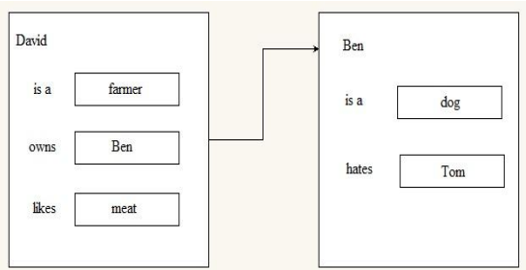
Figure2. Diagrammatic form of frame-based system

Slide 32
The class and instances
A frame also referred to a specific object or a group of comparable objects. To be more specific, we use the actual instance frame while dealing with a specific object as well as the class-frame while talking about a similar object.
For example1, The figure 3 shows a frame example of personal data.
For example2, in figure 4 the frame example of computer “Dell Inspiron5110” is represented.
A class-frame explains a set of objects with typical features. The person, car, and computer are class-frames.
Slots in a frame
The frame can be described by a set of slots. Every slot explains a specific feature or procedure from the frame. Slots are used to keep values. The following common knowledge is included in the slot of frame:
1) The name of the frame.
2) A connection of one frame to other frames

Slide 33
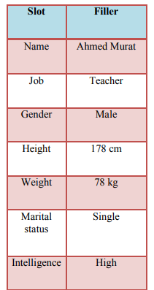
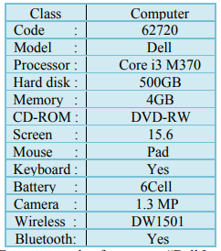
Figure4. Frame example of computer “Dell Inspiron5110”
Figure3. Frame example of personal data

Slide 34
For example, the frame of computer “Dell Inspiron5110” in figure 4 can be a member of computer class which is related to the hardware class;
3) The value of slots: a value of slots may be Boolean, numeric or symbolic. The slot value is usually allocated at the time of creating a frame or within a procedure while using the expert systems
4) Defaulting of slot values: this is actually correct while no evidence on the opposite has been identified; 5) The range of slot values: The field of the slot value fixes whether the specific object is complied with the stereotype necessities outlined by the frame. For instance, the price of a car can range between $5000 and $40000
6) The procedural knowledge: A slot has a procedure connected to it, and this is carried out when the slot value is required or modified

Slide 35
Advantages of frame representation:
The frame knowledge representation makes the programming easier by grouping the related data.
The frame representation is comparably flexible and used by many applications in AI.
It is very easy to add slots for new attribute and relations.
It is easy to include default data and to search for missing values.
Frame representation is easy to understand and visualize.
Disadvantages of frame representation:
In frame system inference mechanism is not be easily processed.
Inference mechanism cannot be smoothly proceeded by frame representation.
Frame representation has a much generalized approach.

Slide 36
Semantic Net
Semantic networks are alternative of predicate logic for knowledge representation. In Semantic networks, we can represent our knowledge in the form of graphical networks. This network consists of nodes representing objects and arcs which describe the relationship between those objects. Semantic networks can categorize the object in different forms and can also link those objects. Semantic networks are easy to understand and can be easily extended.
This representation consist of mainly two types of relations:
IS-A relation (Inheritance)
Kind-of-relation
Example: Following are some statements which we need to represent in the form of nodes and arcs.

Slide 37
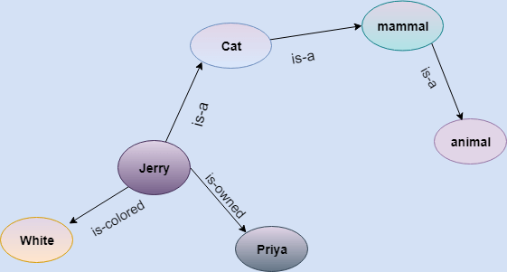
Statements:
Jerry is a cat.
Jerry is a mammal
Jerry is owned by Priya.
Jerry is brown colored.
All Mammals are animal.

Slide 38
